Slide 1
Baum-Welch Algorithm

Slide 2
Learning Objectives
To learn how to derive model parameters probabilistically from unlabeled sequences

Slide 3
Where do HMM probabilities come from?
CpG Island
P(A) = 0.1
P(C) = 0.4
P(G) = 0.4
P(T) = 0.1
0.6
0.1
β
0.4
0.1
P(A) = 0.4
P(C) = 0.1
P(G) = 0.1
P(T) = 0.4
0.9
0.9
Genome
Two general approaches to generating HMM probabilities:
Calculate frequencies from observed data with known hidden states
Baum Welch algorithm

Slide 4
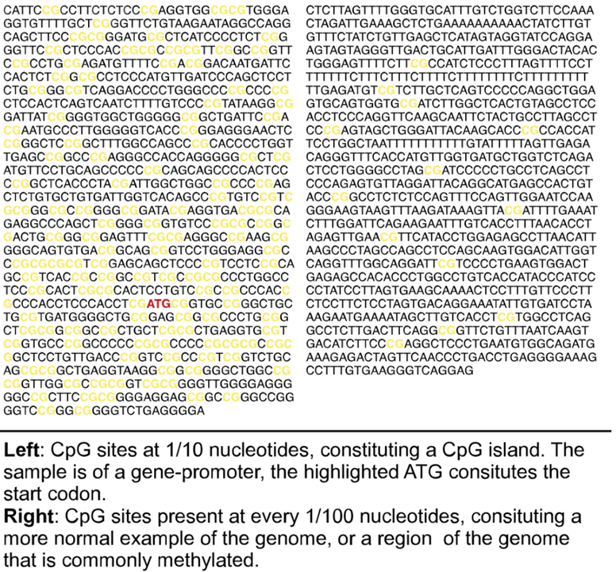
Calculate Frequencies From Observed Data and Known CpG Islands and Non-CpG Islands
CpG Island
P(A) = 0.1
P(C) = 0.4
P(G) = 0.4
P(T) = 0.1
0.6
0.01
β
0.4
0.1
P(A) = 0.29
P(C) = 0.21
P(G) = 0.21
P(T) = 0.29
0.99
0.9
Genome
For example:
If it is known that 1% of the human genome contains CpG islands than our beginning state transition could be adjusted reflect this frequency
If it is know that 42% of the genome contains GC content then we could adjust our genomic frequencies

Slide 5
Baum-Welch Algorithm
The Baum-Welch algorithm is an expectation-maximization (EM) algorithm that estimates model parameters from an observed sequence
Alternative to simply using training data to derive probabilities which may cause the model to be over-fit or may not proper represent sparse state transitions
Baum-Welch is commonly used in bioinformatics:
GLIMMER – program that identifies coding regions in bacteria, archea, viruses DNA (1,080 pubmed citations)
GENSCAN – identifies gene locations, exon-intron boundaries (3,831 pubmed citations)

Slide 6
Baum-Welch Algorithm Description
Starting with N sequences of data with unknown states
Goal: Identify HMM state transition probabilities and emission probabilities
Randomly assign probability estimates (or set to pseudocount values)
You can also randomly assign states to each observation and calculate the probability estimates from them
For each sequence:
Use Forward and Backward algorithms to calculate expected frequencies
Use posterior decoding to assign most probable states at each observation
Update probability estimates based on these states
Repeat steps 2a and 2b until probability estimates stop changing

Slide 7
Baum-Welch Example
CpG
Gen
CpG
CpG
CpG
Gen
Gen
Gen
1. Assign random states
A | C | G | C | G | A | T | C
2. Calculate initial model
3. Assign new states based on posterior decoding
CpG Island
CpG
Gen
Gen
CpG
CpG
Gen
Gen
Gen
P(A) = 0.25
P(C) = 0.25
P(G) = 0.50
P(T) = 0.00
A | C | G | C | G | A | T | C
0.5
1
4. Repeat 2-3 until model converges
β
What defines convergence?
Until probabilities do not change after a single iteration -or-
Until probabilities do not change after multiple iterations -or-
Until probabilities do not change (within some threshold) -or-
Until a maximum number of iterations is reached
The determination for what criteria to use for convergence can be arbitrary and is often tailored to the specific model being constructed
0.5
0.33
P(A) = 0.25
P(C) = 0.50
P(G) = 0.00
P(T) = 0.25
0
0.67
Genome

Slide 8

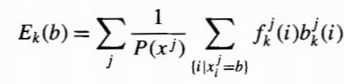

Baum-Welch, Formally
Baum-Welch estimates A_{kl} and E_{k}(b) as the expected number of times each transition or emission is used, given the data
A_{kl} = number of transition from state k to l
E_{k}(b) = number of emissions of observation b from state k
B_{k} = initial probability for state k
We can update A_{kl} and E_{k}(b) as follows from a set of j sequences:
Current emission probability for observation x at position i+1 in sequence j
Current transition probability from state k to l
Initial State Matrix
forward variable
backward variable

Slide 9
Baum-Welch
As you might expect, a larger set of data with more opportunities for transitions between states will allow for more accurate models to be generated
Also, in the previous example, we used ‘CpG’ and ‘Genome’ as states, however these are just labels and the initial random nature of the model could result in convergence where the ‘Genome’ model is actually reflecting the CpG pattern. Computers don’t understand labels!
Prior knowledge of the model to be generated may allow for non-random initial states, e.g. setting all C and G nucleotides to the CpG initial state.
However, by definition this results in a non-random bias to your model.

